Slide 1
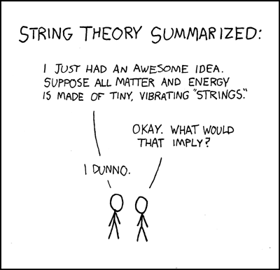
Managing and manipulating character data and strings in R

Slide 2

What is a string?
string = c(“This”, “is”, “a”, “string”)
String = “So is this”
One is a vector of 4 objects composed of 4, 2, 1, and 6 characters each
The second is a vector of 1 object composed of 10 characters (8 letters and 2 blank spaces)

Slide 3
Why do I care?
Non-numeric data is not intuitively manipulated, managed, or analyzed
Genomic data is base pair sequences, not numbers
Statistical analyses often return results as lists composed of both character data/vectors and numeric data/vectors
How best to manipulate those results?

Slide 4
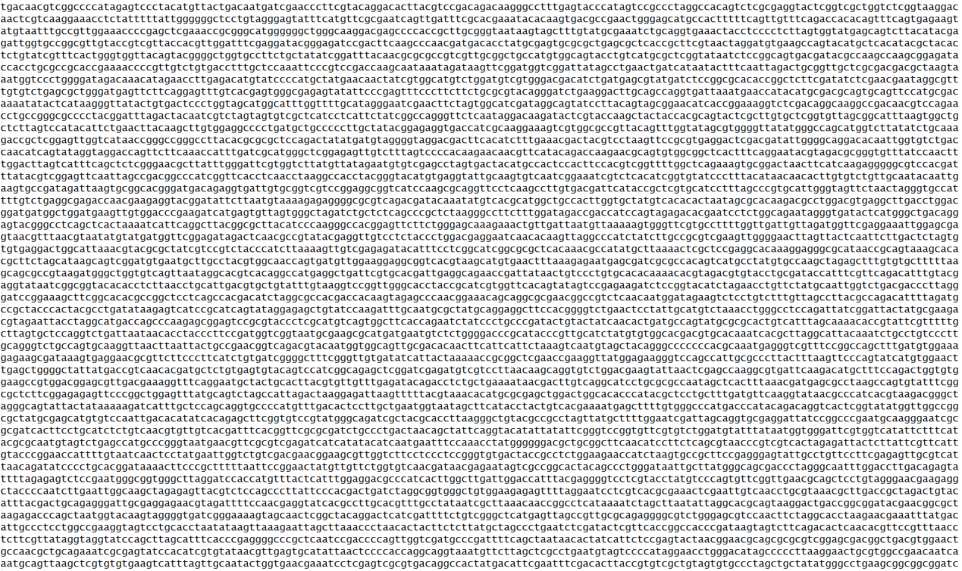
Example character string

Slide 5
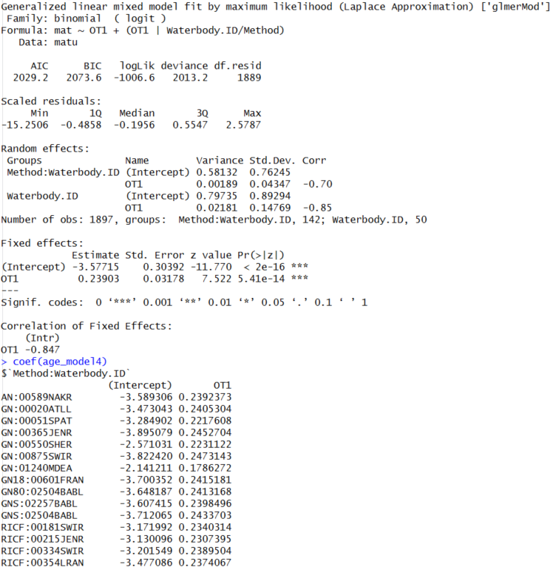
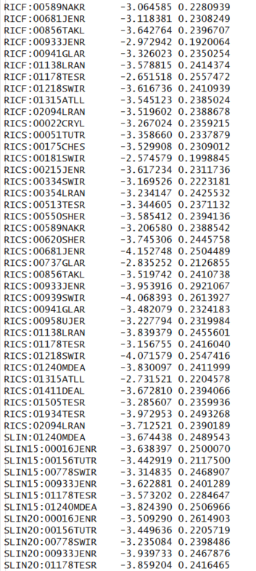
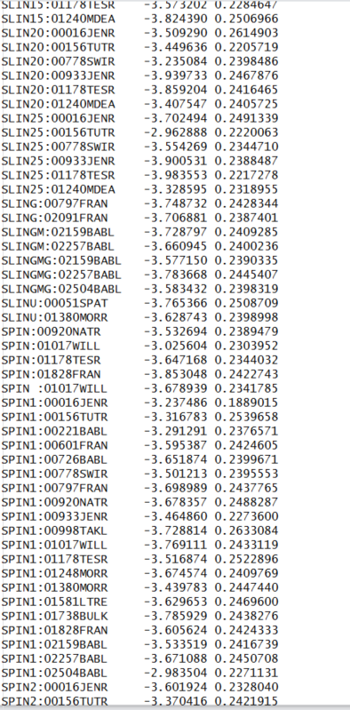
Another example
“RICF:00589NAKR” is the sampling gear “RICF” and the lake “00589NAKR” and has two parameters estimated

